Slide 1
Business Retention & Expansion – Developing New and Growing Existing Businesses
Lynn A. Knight, CEcD

Slide 2
Key Facts About Business Retention And Expansion
80%+ of growth comes from expansion of existing firms
BRE is essential intelligence gathering
BRE can help speed up local investment
It can also slow down, or even stop exits

Slide 3
Key Facts About Business Retention And Expansion
80%+ of growth comes from expansion of existing firms
BRE is essential intelligence gathering
BRE can help speed up local investment
It can also slow down or stop exits
But, 100% of all jobs are in existing businesses!

Slide 4
Why Focus on BRE?
Shows businesses they are important and that their government and the community at-large cares about them.
Helps businesses and government become more aware of each other and how they can help each other.
Identifies business concerns and opportunities to address in a proactive manner.
Leads to a growth in jobs, incomes, and investment by learning about business plans and how to help them.
Reduces job loss as preventable closures and relocations can be addressed before it is too late.
Informs government policies to improve business climate.
Is more a cost-effective form of business development than recruitment of inward investment.
Notes:
Slide from Joy Wilkins

Slide 5
And…
If you can keep those you have happy, they will be your best community ambassadors... and tell your story for you!
Notes:
Slide from Joy Wilkins

Slide 6
Why Businesses Relocate
Unfavorable changes
Expansion & needs for additional facilities
Need for different infrastructure
Trouble with workforce
Better opportunity in another market

Slide 7
BRE Program Components
RELATIONSHIP BUILDING
RESPONDING TO NEEDS
MANAGEMENT & FOLLOW-UP
TEAM BUILDING
Research, Research, Research

Slide 8
Properly Implemented BRE Programs
INCREASE COMPETITIVENESS & MAXIMIZE GROWTH POTENTIAL
REMOVE OR MITIGATE LOCAL OBSTACLES
DEVELOP CONTINGENCY PLANS
COMPANY CLOSINGS & ECONOMIC CHANGES
MAINTAIN CONFIDENTIALITY & FOLLOW CODE OF ETHICS

Slide 9
What Do We Need to Know?
Notes:
Slide from Joy Wilkins

Slide 10
Business Demographics
Industry sector
Number of employees
Number of owners
Ownership type
Structure (corporate, partnership, LLC, franchise, sole proprietorship, home-based)
Years in business
Notes:
Slide from Joy Wilkins

Slide 11
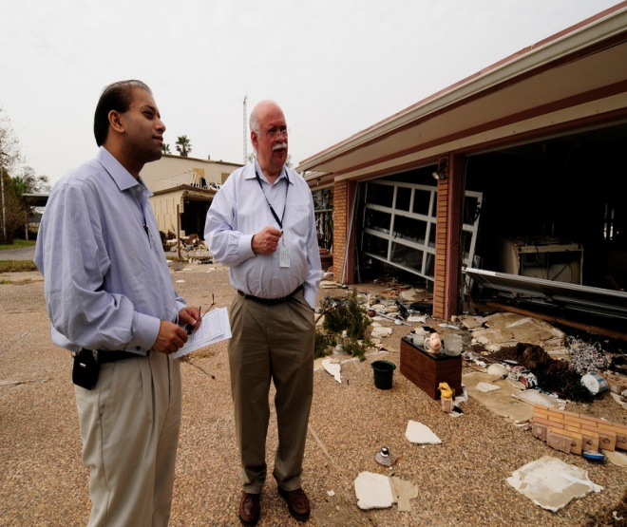
Business assessments
Volunteers are conducting assessments on:
Business interruption and what it means to the local economy
Loss of revenue
Workforce issues
Damage to property, supplies
Damage to supply chains
Infrastructure issues
Opinions of what help would make a difference
Notes:
Third party assessments
Sometimes beneficial to have third party conduct analysis, because of:
Limited local capacity
Assurance of a faster process
Need for unbiased perspective
It’s important that all stakeholders understand the findings of the economic analysis
A deep understanding of the current situation and long-term vision for the community will provide critical insights and help align work

Slide 12
Possible Questions to Ask
How did you pick ___ for your business?
Why keeps you in ___?
What are the positives (strengths) of doing business in ___?
What are the negatives (challenges) of doing business in ___?
Are there any trends or developments within your industry affecting your ability to sustain or grow your business?
What major issues are you dealing with today? What’s keeping you up at night?
If you could name ONE thing that would make a fundamental difference in the life of your business, what would it be?
Notes:
Slide from Joy Wilkins

Slide 13
If Nothing Else…
How satisfied are you?
What major issues are you dealing with today?
What can we do to make your life easier?
(how can we best serve you?)

Slide 14
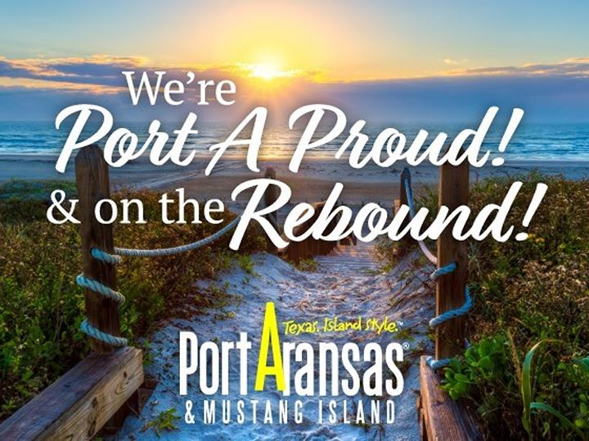
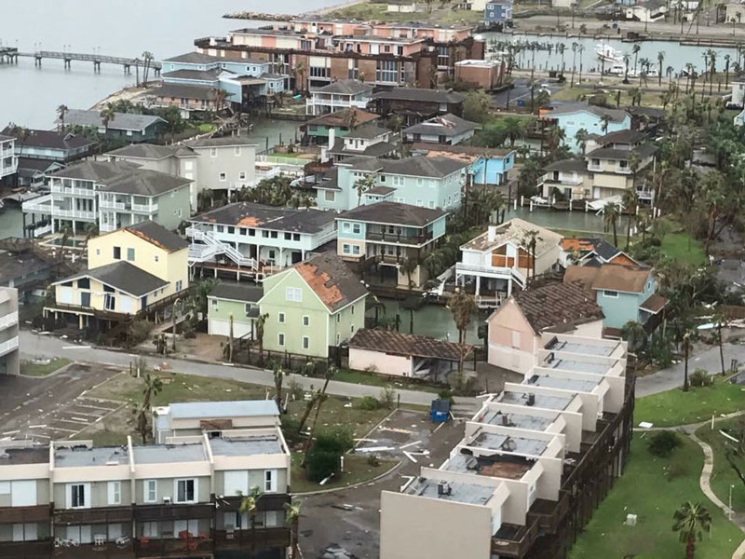
Port Aranzas, TX BRE Example
After Hurricane Harvey, the downtown was flooded and small businesses were struggling
Business assessment was conducted in December 2017
Assessment was administered through paper surveys and interviews done by volunteers
During confidential interviews questions were asked about business conditions, what problems businesses needed solved to help with recovery
Notes:
http://www.eugenechamber.com/business-retention--expansion.html
https://www.eugene-or.gov/

Slide 15
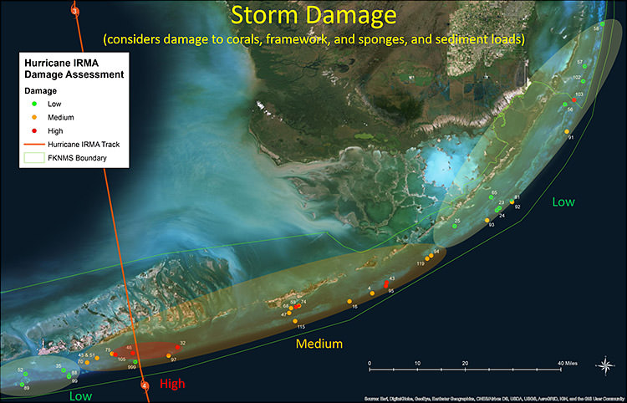
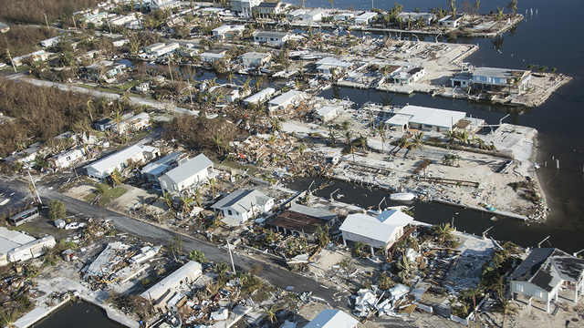
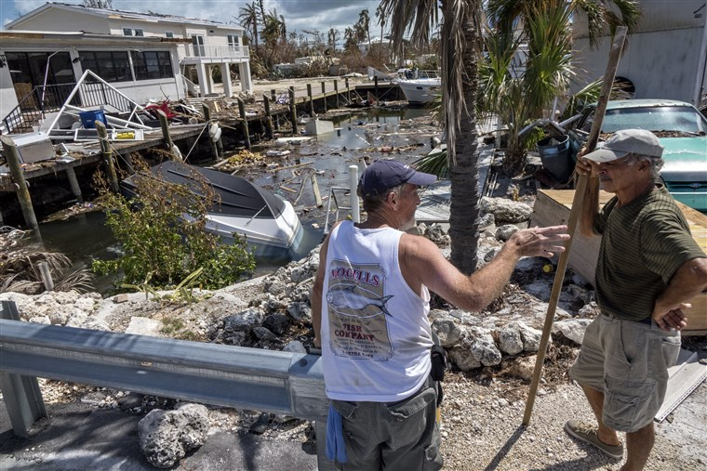
Florida Keys BRE Example
Since Hurricane Irma, many businesses large and small have experienced difficulties
Business assessment was conducted during May-June 2018
Assessment was administered through paper survey, Survey Monkey online survey and personal interviews, business organizations, etc.
Results are being written up for the County government, business organizations, federal government
Notes:
http://www.eugenechamber.com/business-retention--expansion.html
https://www.eugene-or.gov/

Slide 16
What questions have you asked since the hurricanes? Who is asking? What are you finding?
Group discussion
Notes:
Slide from Joy Wilkins

Slide 17
Red Flags / Responding to Needs
Analyze data and information from businesses
Immediately respond to red-flag issues
Develop long-term programs, policies & strategies that address concerns
Develop customized solutions
Notes:
http://ofallonchamber.com/what-is-bre/

Slide 18
Common Red Flags
Declining sales/declining employment
Larger, non-local corporate ownership
Recent ownership change
Lease of property/expiring leases
Other facilities producing the same product or service
Negative attitudes about the community

Slide 19
Common red flags
High regulatory burdens
Labor problems
Expanding employment/expanding sales
Facility and site expansion plans
Obsolete or severely damaged facilities
Location in problem-neighborhood
Older technology, no technology

Slide 20
Common red flags
Contentious labor-management relations
Lack of export/international focus
Family-owned firms with aging owner or no succession plans
Gradual downsizing over time
Relocation of managers and corporate officers
Loss of longstanding supplier contracts

Slide 21
DISCUSSION: What are some ways we can help businesses in the USVI? Based on USVI’s assets, what are some businesses that could have potential here and why?

Slide 22
How we can help existing businesses: Technical Assistance
Creates tremendous goodwill
Increases competitiveness in wider marketplace
Assists with re-opening, renovations, expansion
Hinders relocation to other areas
Helps biz survive economic difficulties

Slide 23
Technical Assistance Examples
RESEARCH INITIATIVES, ANALYTICS PROGRAMS
SITE CLEANUP, INFRASTRUCTURE ASSISTANCE
INCENTIVES
CONTINUITY PLANNING, PRE/POST-DISASTER PLANNING
PARTNERSHIPS

Slide 24
Financial Incentive Examples
VENTURE CAPITAL
DIRECT LOAN & GRANT PROGRAMS
REVOLVING LOAN FUNDS
UTILITY DISCOUNTS
SMALL-ISSUE FINANCING
LOAN GUARANTEES
AID FOR RENOVATION OR EXPANSION

Slide 25
Importance of the Right Response
Develops a community culture for appreciating and supporting local businesses
Creates loyalty among businesses who feel “loved” by community
Leads to spinoff activity by businesses
Facilitates partnerships and collaborations among businesses
Helps foster a culture for entrepreneurship
Being “business friendly” becomes a vital and truthful element in the community brand
Prompts business owners to “sell” community to other prospective business investors through word of mouth

